Slide 1
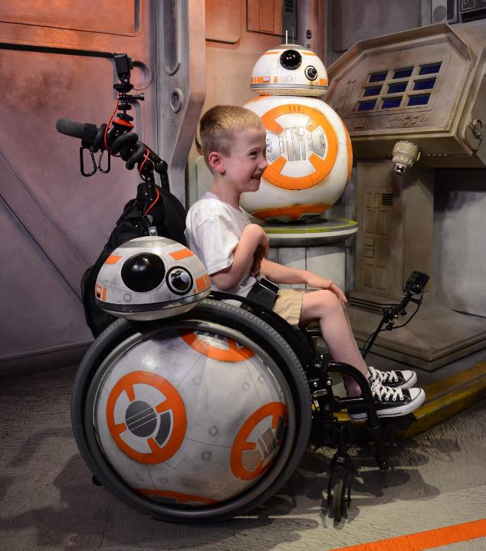
BB-8 Wheelchair
Build Documentation

Slide 2
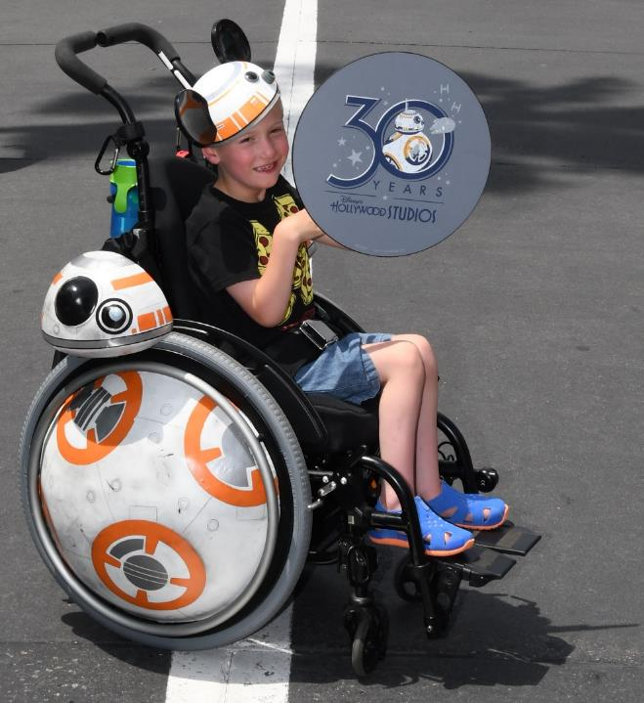
Here’s the BB8 Chair at Hollywood Studios in May 2019.
I created this chair for my son, Coen, as we were taking him on his first trip to Walt Disney World, and planned on being at Hollywood Studios for Star Wars day – May the 4th.
I have been blown away with the responses we received on this project. There was encouragement to share, so here we are.
I do know there are plenty of inaccuracies for the BB8 purists looking, but that wasn’t the point of the build.

Slide 3
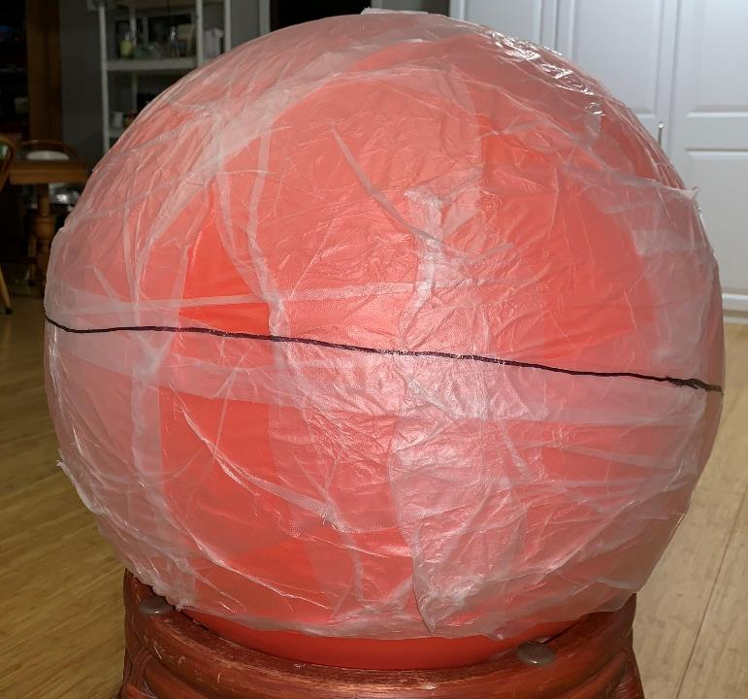
I started with a yoga ball and wrapped in Press-n-Seal. I did this to help as a release for the casting material that will be wrapped around the ball.
I added a rough center line as a reference for where I wanted to cut the ball in half.

Slide 4
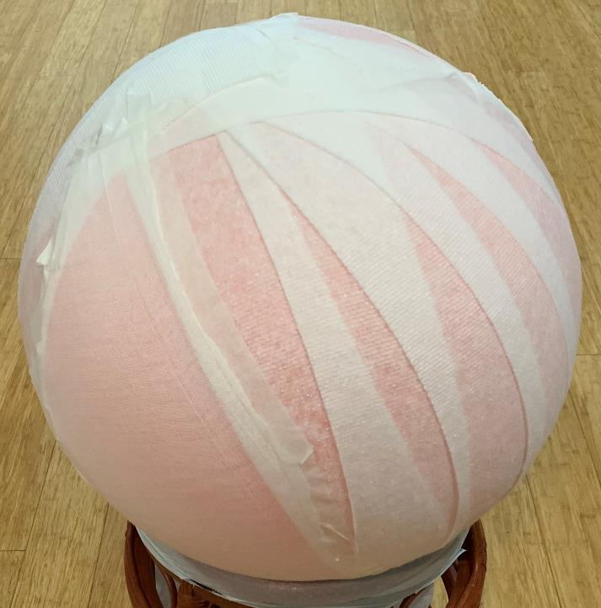
I wrapped the ball in cotton batting so the casting material had something to bond to other than itself.

Slide 5
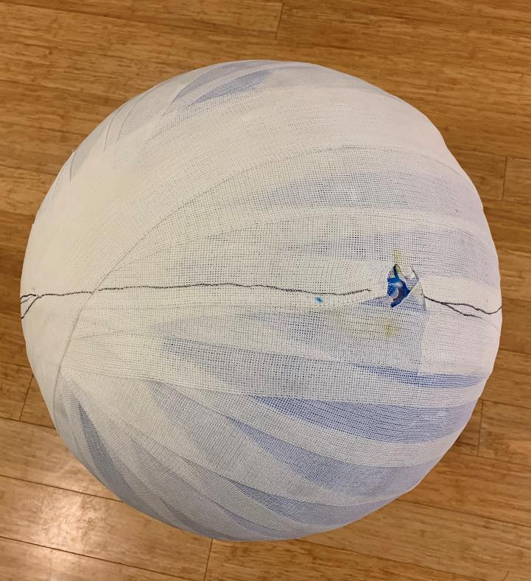
I have wrapped the ball in cast material. It’s the stuff you would get if you had a broken arm. I have a friend that works for an orthopedic clinic and they had some that was expired that they were going to throw away.
I added a cut line as well as left a hole so I could pull the plug on the yoga ball and deflate it prior to cutting.

Slide 6
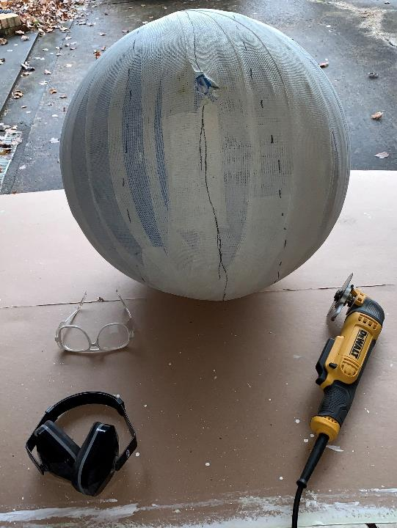
I used a DeWalt oscillating tool to cut the ball in half. I managed to accomplish this without cutting the yoga ball.

Slide 7
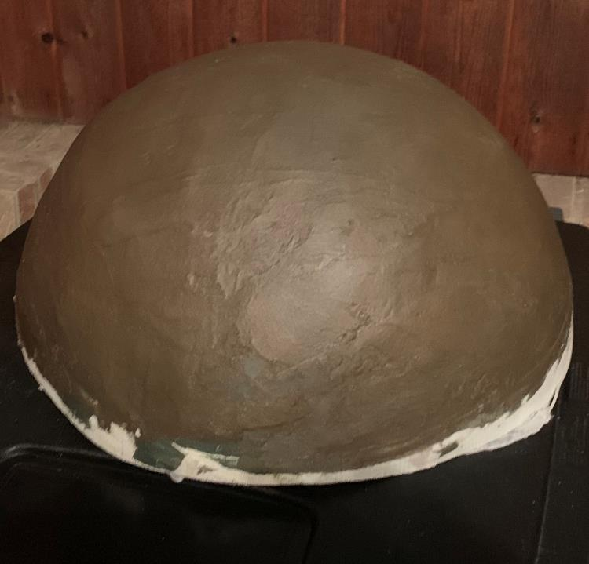
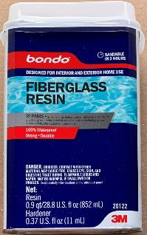
I used Bondo Fiberglass Resin (from Wal-Mart in the automotive department) to coat the outside of each dome.

Slide 8
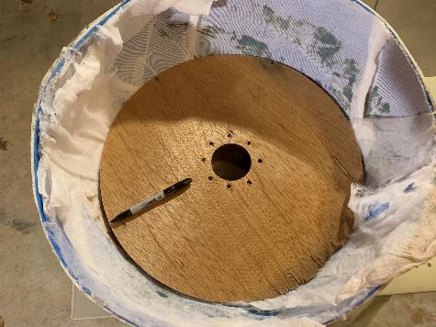
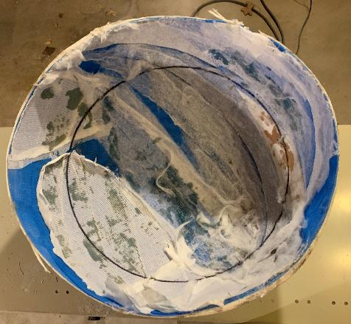
I used an 18 inch disk that I had previously used to make flat wheel covers to mark the inside of the domes. I used this as a guide to cut the dome to usable size.
I used the oscillating tool to cut around my guideline to cut it down to size.
NOTE: This was a learning point, as I realized I should have done this step before putting all the fiberglass resin on. I could have done a variety of things, but even as simple as drilling reference holes to know where I needed to stop the coating would have saved a lot of resin and time.

Slide 9
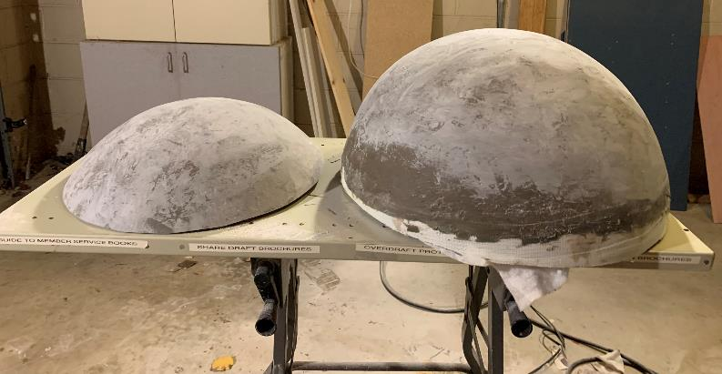
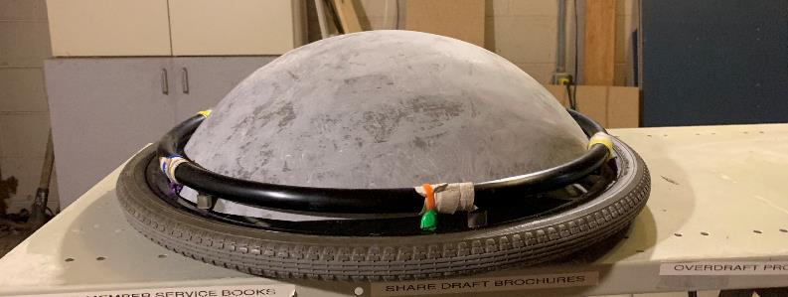
Here is a comparison of the final size of the dome next to the original size.
I have sanded the domes, so that is the variation in color and to smooth out my hack job of applying the fiberglass resin.
This is a placement of the cut down dome in one of the wheels
NOTE: We ended up getting a new wheelchair during this build, so the final chair is not what I was using for the build. It ended up having the same size wheels although there were a different style. It all fit and worked out in the end!

Slide 10
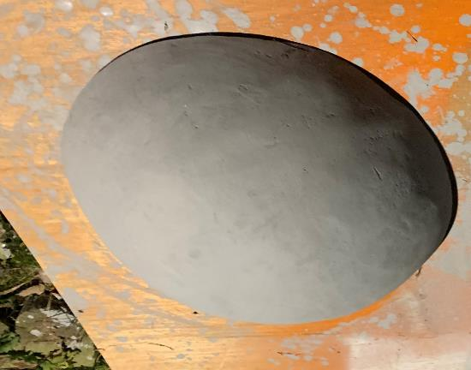
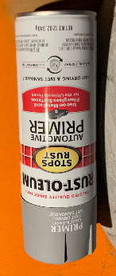
I used Rust-Oleum Automotive Primer to prime the fiberglass resin
I missed some pictures in my build process, but I sprayed the domes with a solid white base.
I did end up filling in a few of the really bad grooves/divots with regular drywall compound. I used the 90 minute bag that I mixed myself so it would dry quickly. I figured it would be painted and sealed, and it ended up working well. I don’t think it would have worked for the entire project, but for a quick repair it worked.

Slide 11
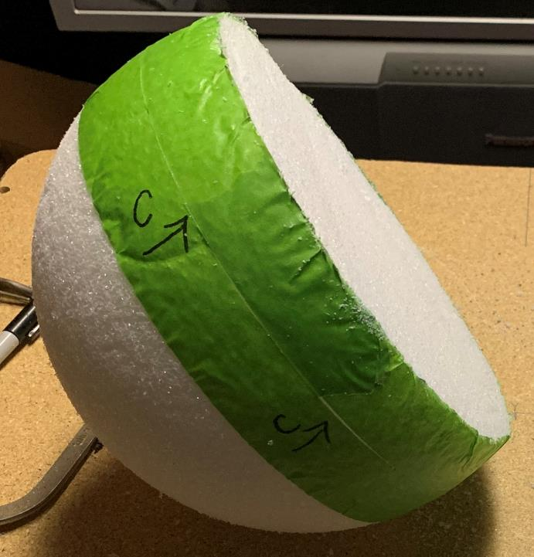
To make the BB8 head, I started with a foam craft ball.
I put the tape around the center, on either side of my center line (the ‘C’ with arrow). I used the 2 inch masking tape as the depth of the taper for the lower side of the BB8 head.
I cut the excess off, finding that a long bladed utility knife the best tool I had to accomplish the cut.

Slide 12
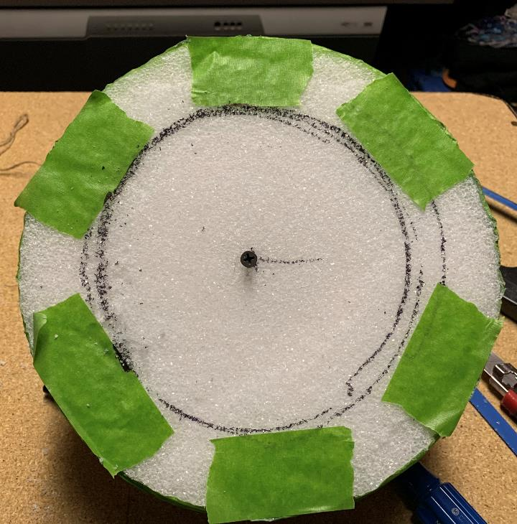
This is the bottom of the ball that I just cut flat.
I added 2 inch tape around the edge to get the spot I wanted to end the taper.
I put the screw in to try and attach a piece of string and marker to make the construction lines. Can’t say that was the best technique in the end, but it provided a reference line for the taper.

Slide 13
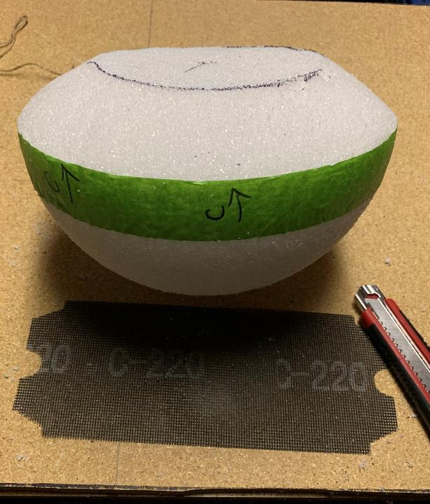
Using a utility knife for the main cut and the 220 grit sanding mesh, I came up with a taper for the bottom part of the head.
The 220 grit sanding mesh worked really well to get the taper smooth and the bottom flat.

Slide 14
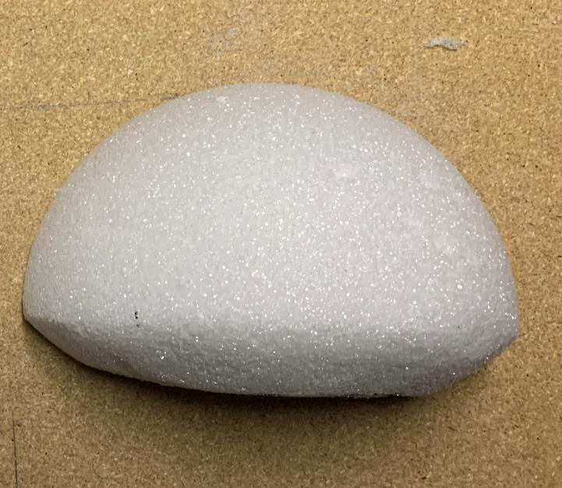
Here is the end result of cutting out the main shape for the BB8 head.

Slide 15
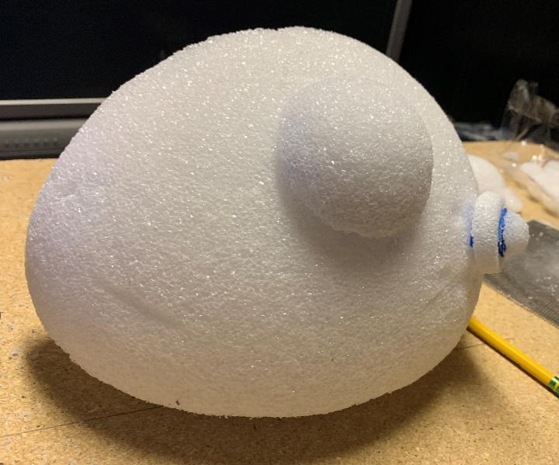
For the lenses/sensors I used other craft foam balls as well as a small section of a foam cone to create the smaller sensor.

Slide 16
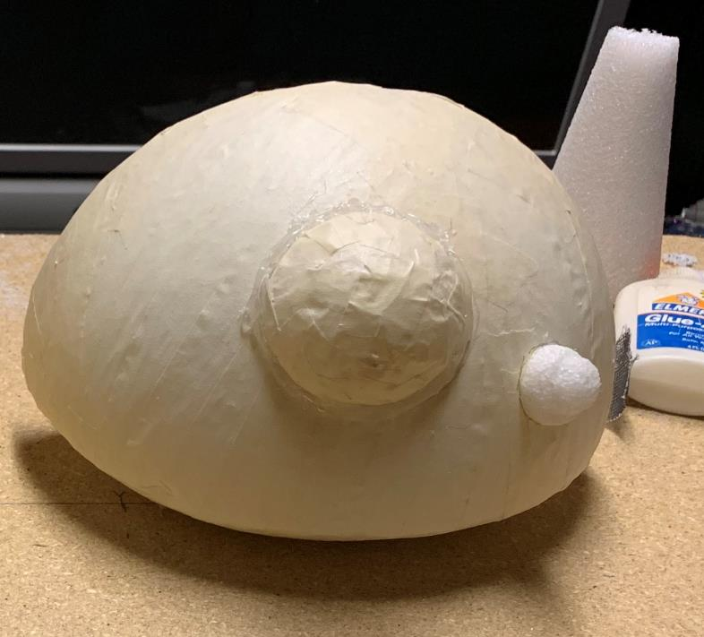
I glued the sensors on using hot glue. I taped everything so I could spray it with primer. I did this as the fiberglass resin eats away the foam. I needed the foam to last until the fiberglass dried enough to maintain shape.
Then use fiberglass resin and patching mesh to cover the head.
Unfortunately, I don’t have pictures of this part of the process. I cut chunks of the fiberglass mesh and used a disposable paint brush to apply it to the head.

Slide 17
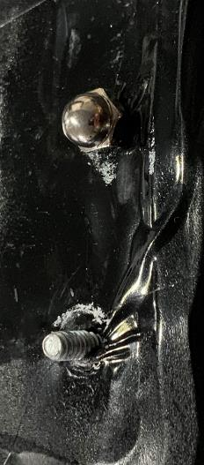
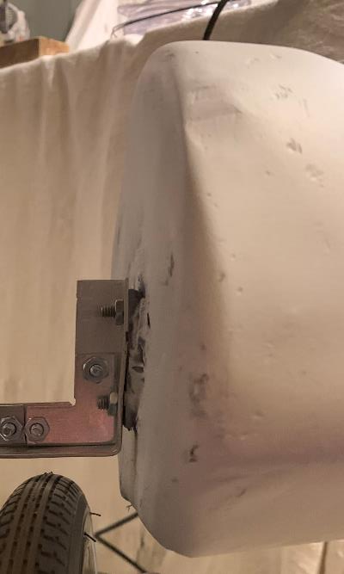
I used JB Weld to bond a small flat bracket with bolts sticking through to have a mounting point to the wheelchair.
I did put the bracket/bolts on the head on at an intentional angle so the head leans back some. This was done to try to keep the head back a little so there was still access to the wheels so it could be manually propelled.
I had to grab pictures from later in the process to try to document this, but I hope it gets the idea there. I’ll discuss the other components later.

Slide 18
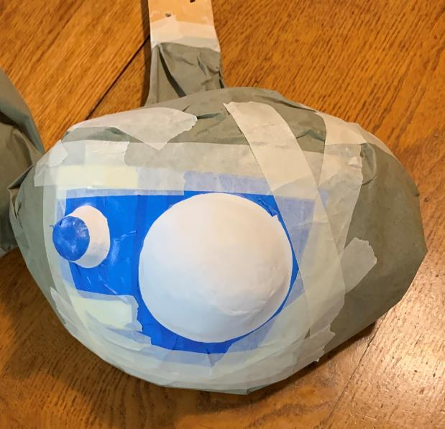
In my failure to document some of the process, here is the head mid paint
I primed the head using the same automotive primer.
I then sprayed a base white coat.
I have masked off the head to paint the sensors black. The tip of the small sensor will end up be a light blue color.

Slide 19
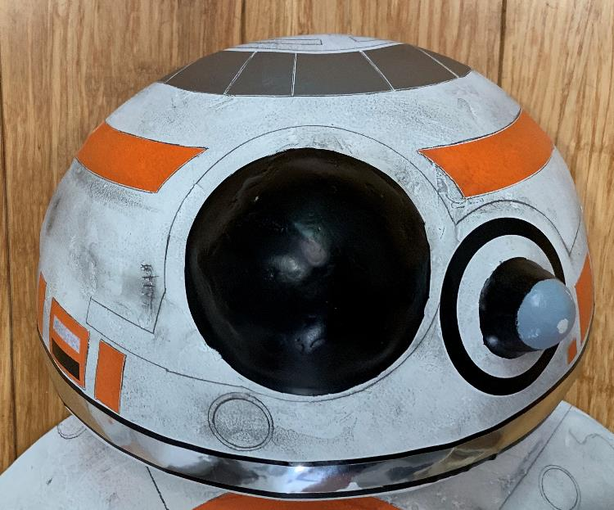
Here is the finished head.
The orange, silver, black, and white detail is all Cricut adhesive vinyl.
The upper orange was cut out as a circle on the Cricut. I cut it into quarters and free hand cut the arcs by the main sensor.
The black ring around the small sensor was a simple circle cut on the cricut.
The bottom sripe was a layer of black then a slightly thinner layer of metallic silver.
The remaining gray and orange were free hand cuts.
Finally I outlined all the vinyl with pencil and added the other detail is pencil using whatever I could find for straight edges or curves.
The distress is pencil. Any spots that I didn’t get smooth, I used as accents and tried to darken it to make it appear as damage. I rubbed the side of the pencil on paper to create a large “colored” spot then rubbed that on the head to create the dirty look.

Slide 20
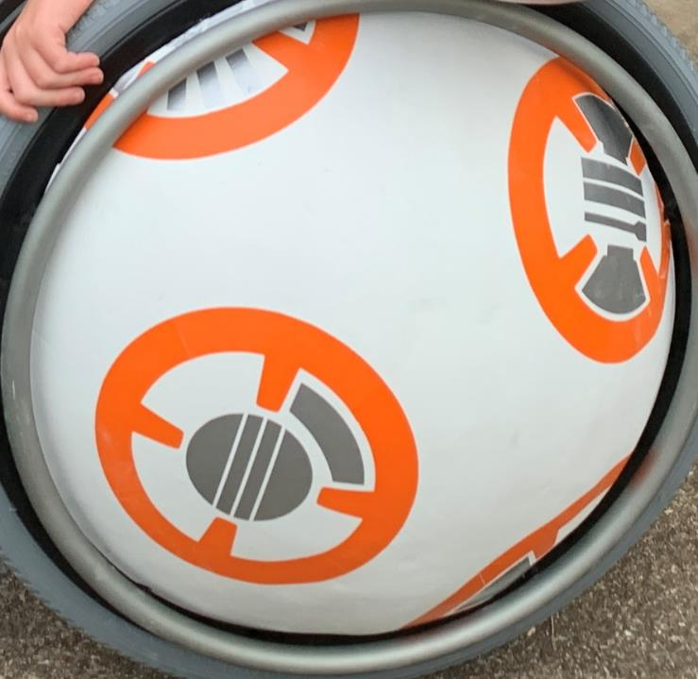
The orange and silver details on the base are again, Cricut adhesive vinyl.
I had to take the orange circles and cut them into quarters, with the inner “spoke” being the center of each quarter.
I tried to lay down a complete cut out of the orange, but a 2 dimensional cutout does not lay properly on a compound curve / dome. My solution was to cheat and cut them into quarters.
The silver was cut out on a Cricut. The detail in the upper right circle – the three bars that one looks like a flashlight – were cut freehand using a blade and straight edge.
The detail work in pencil was the same process on the base as it was on the head. Trace the vinyl and then distress it.

Slide 21
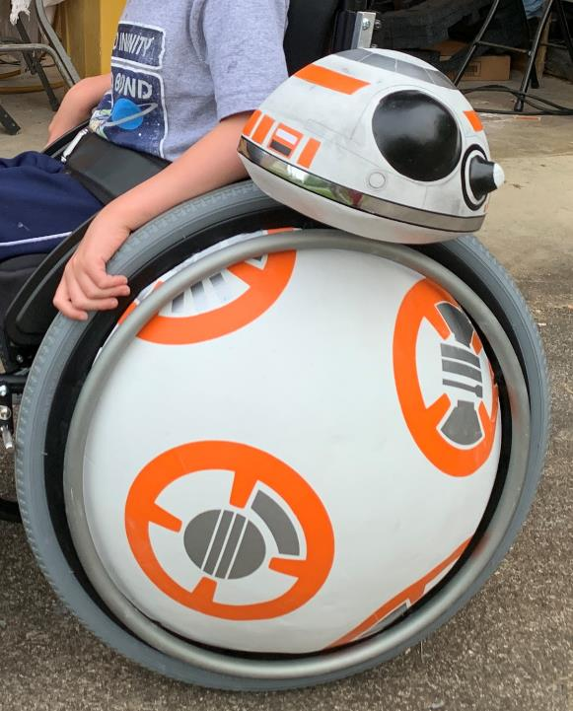
I’ll go over the mechanics of mounting BB8 later.
Here is a test run with BB8 mounted. You can see the detail work done on the head vs. the base where I have not detailed it yet.
Note: This is the new wheelchair vs. the earlier one when I did a test fit of the base.

Slide 22
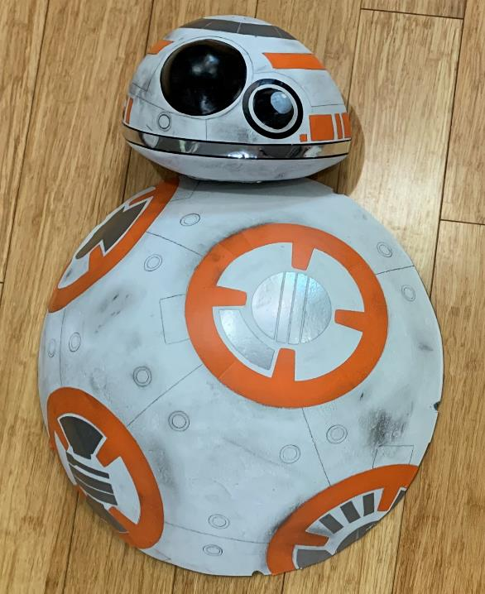
Here are the final detailed BB8 (one half anyway). I used Minwax Water Based Polycrylic Protective Finish Clear Satin as a clear coat to protect the build.
I used a spray gun as any moisture rubbed against the pencil would cause smearing. The clear coat made the pencil a darker so it became a little bolder in the end.

Slide 23
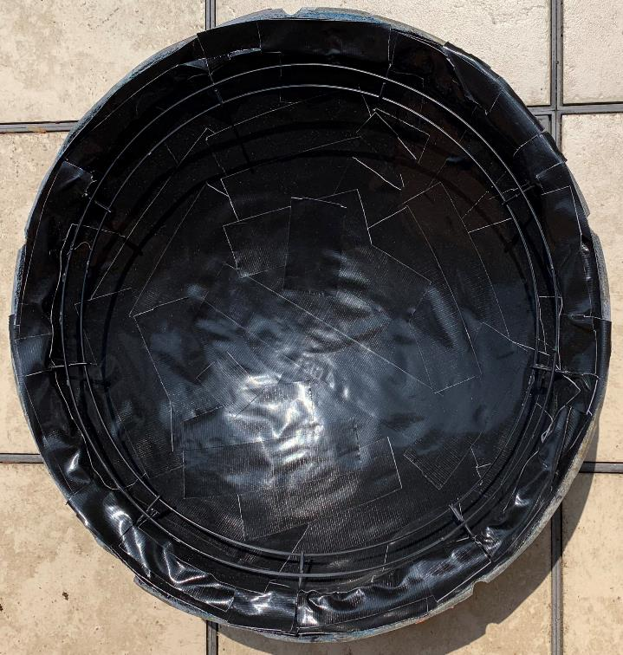
I used a wire frame wreath base to add stability and mounting point for the base. I used construction adhesive to secure it. The added stability was very beneficial to add rigidity to the dome
I had a problem where some fiberglass resin never cured, so the bases had a very strong smell. I ended up using gorilla tape to tape the inside of the dome. This sealed in the smell, so it wasn’t a problem.

Slide 24
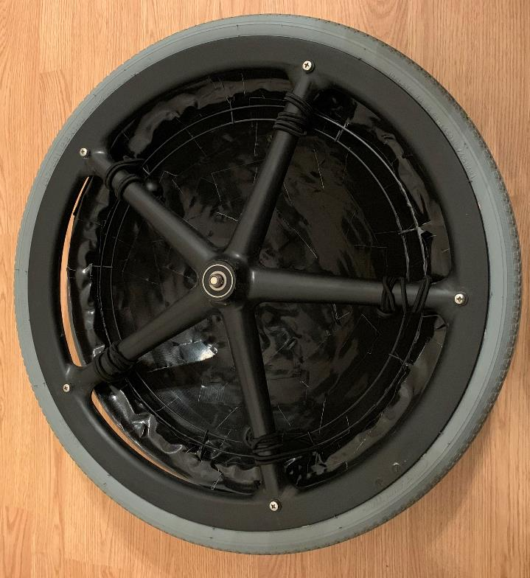
I removed the hand bar from the wheels and put the base inside, then reattached the hand bar.
I used elastic cord with balls to keep the base secure with the wheel by lacing it around a wheel spoke and through the wreath base I glued inside the dome. I picked these up the hardware store.

Slide 25
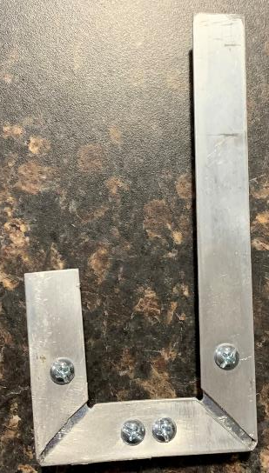
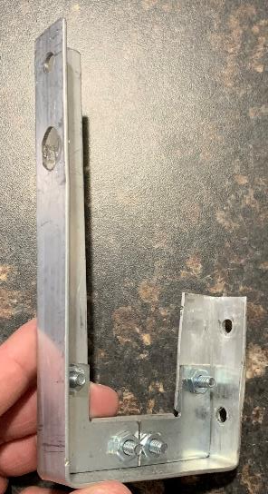
To mount the head, we removed the arm rests from the chair. They were too high for us to use, so they were unnecessary. This have me a couple mounting points for the head.
I purchased aluminum L and formed it into a mounting bracket. The longer edge mounted to the frame of the wheelchair. The short side is what the bolts I attached to the head fit.

Slide 26
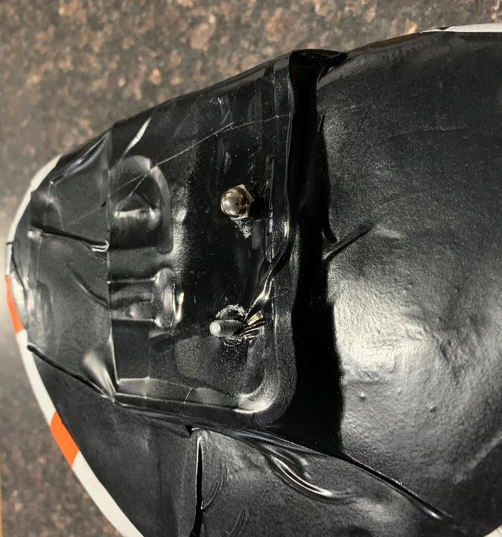
I wasn’t confident in the stability of the JB Weld holding the bracket and bolts onto the head.
I scrounged around the garage and found an old license plate. I cut it in half, and bent both pieces in the middle to create a platform for the head to be glued (construction adhesive) to. I drilled holes for the bolts to pass through as it was bolted to the frame of the wheelchair.
It definitely isn’t the most elegant solution, but I used what I had quite literally laying around.
I used spare black vinyl to cover the back and bottom of the head.

Slide 27
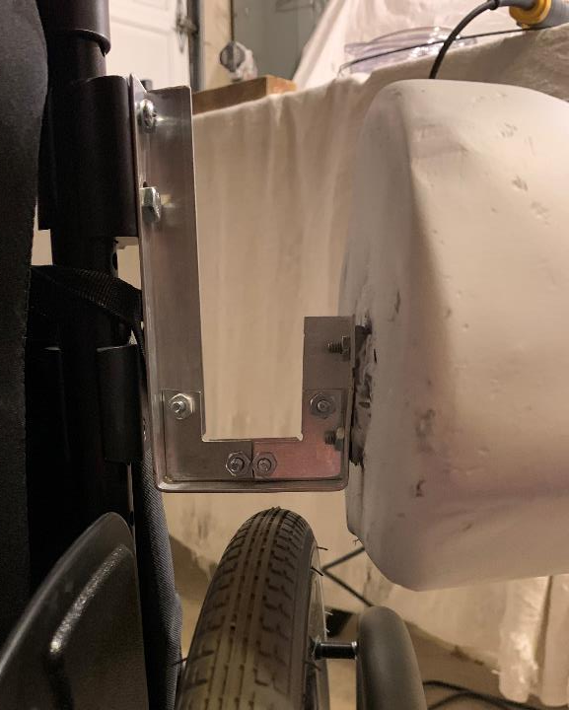
This is the ‘J’ bracket in a test. (I don’t have the support on the head yet).
I tried to build it so the BB8 head was lower than the wheel, but he ‘J’ bracket didn’t rub the wheel. This is how it turned out.

Slide 28
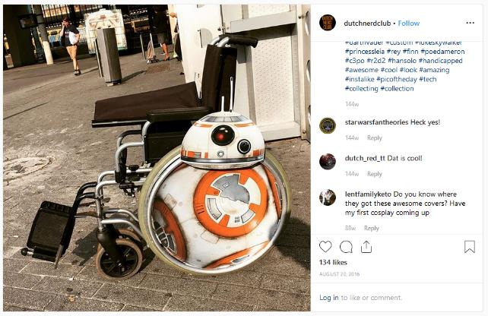
When I started researching something to do for this project, we look for “BB8 Wheelchair”. This was the image result that I took my inspiration from:
https://www.instagram.com/p/BJUkdDgDNfr/
After I started I realized that this is all flat. It just looks 3 dimensional. Once I figured that out I was already into the build far enough that I was continuing down that path.

