Slide 1
Addams Family Electric Chair

Slide 2
Inspiration drawn from a scene in the movie where Wednesday straps Puglsey into the chair. The costume featured several strobe lights and crackling/sparking sound effects that came on when Wednesday pulled down three switches.

Slide 3
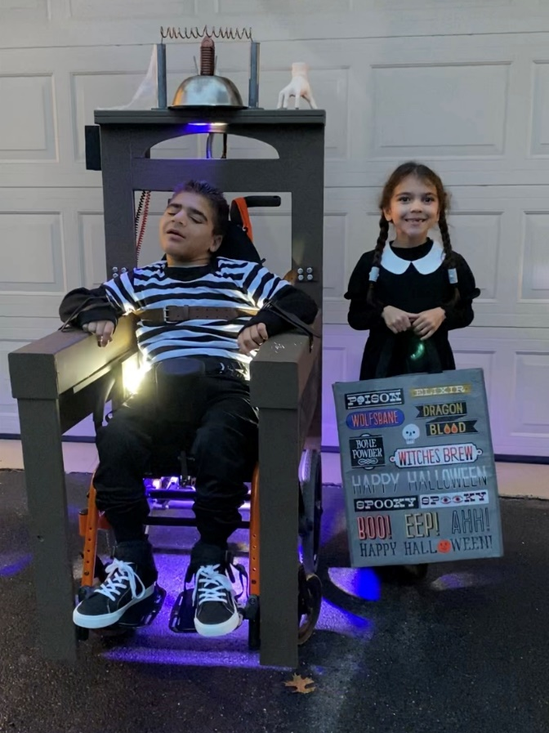
Lights were automotive 12-24v strobelights. One mounted at the top of the chair to shine down, one on the side of each armrest, and two below the chair on a removable plate. The lights were wired in parallel and I used a 12V battery to power everything, and standard lightswitches served as the switches.

Slide 4
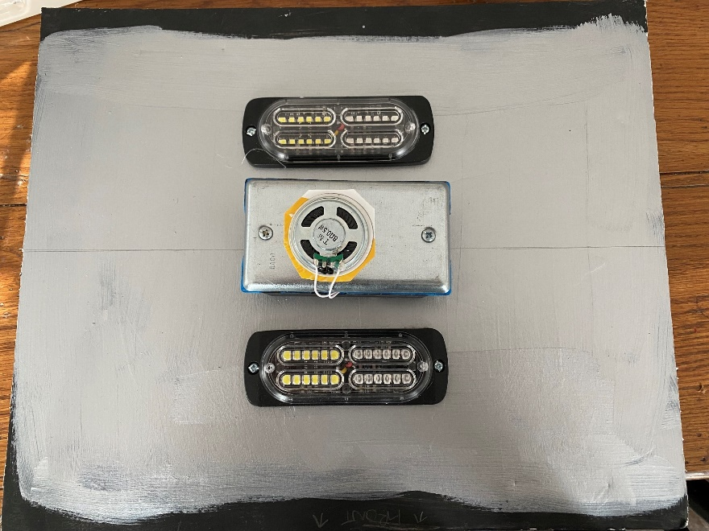
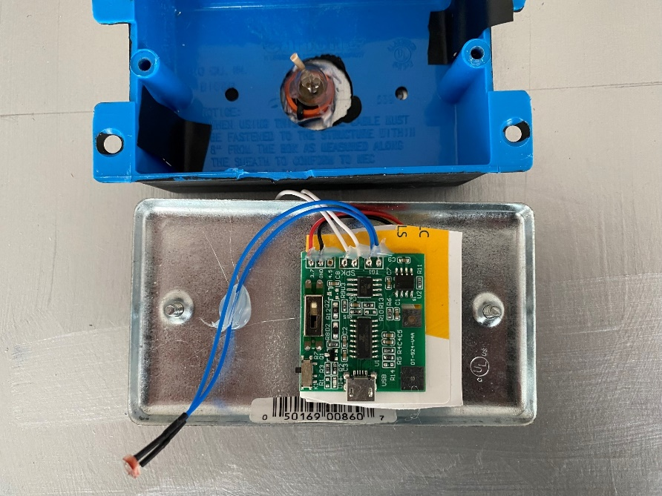
Sound was a light activated recordable sound chip (used for birthday cards). Mounted the speaker portion to a blank switchplate, put the other components (circuit board and photoresistor) in a junction box and mounted that to the Bottom Light board. Put a small lightbulb (rated at 12V) and wired that with the rest of the lights. When the lights were on, electrical sound effects played until the lights were switched off, or for one minute.

Slide 5
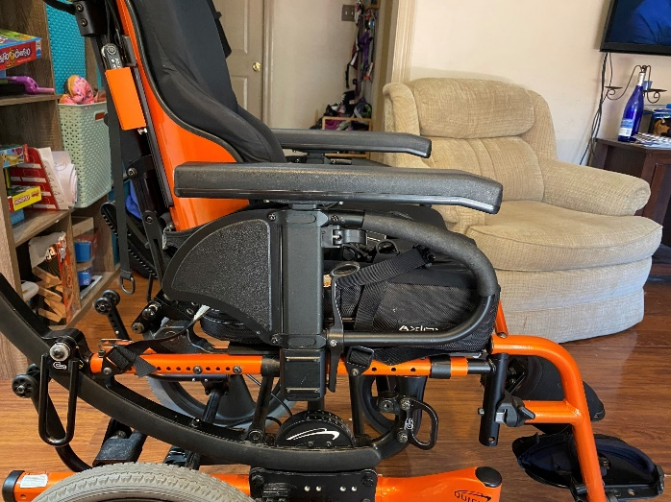
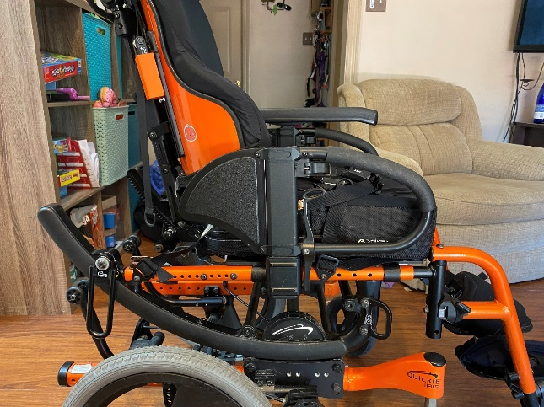
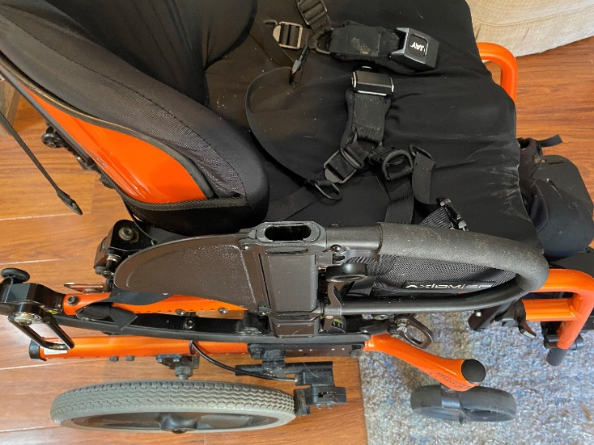
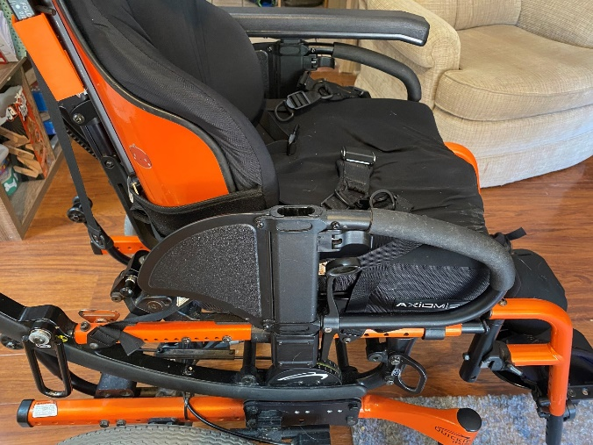
Mounting the costume chair onto the wheelchair. The armrests of the wheelchair were removable.

Slide 6
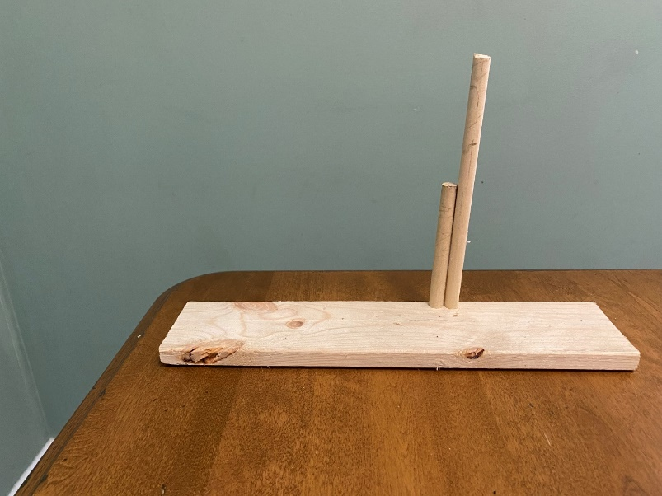
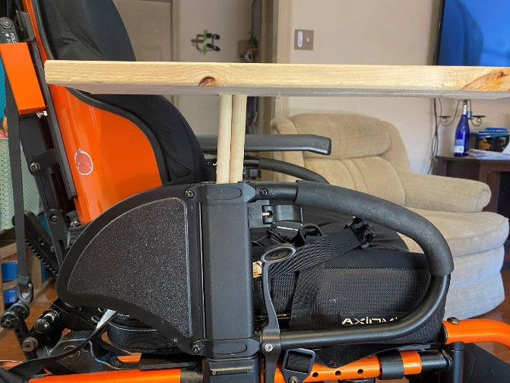
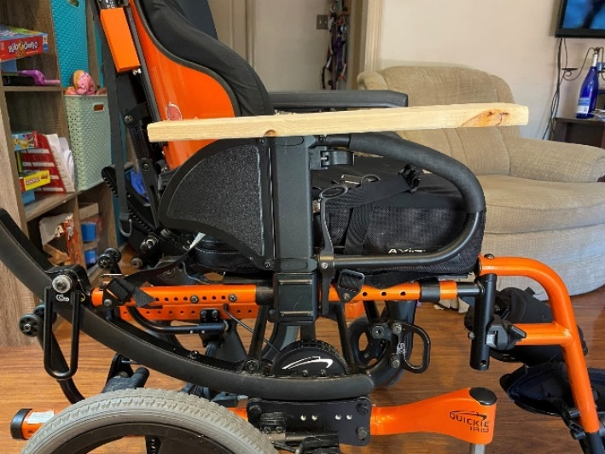
Fabricated some supports for the costume chair out of two pieces of ½ dowel that fit right into the wheelchair armrests. Those supports were then mounted to the costume.

Slide 7
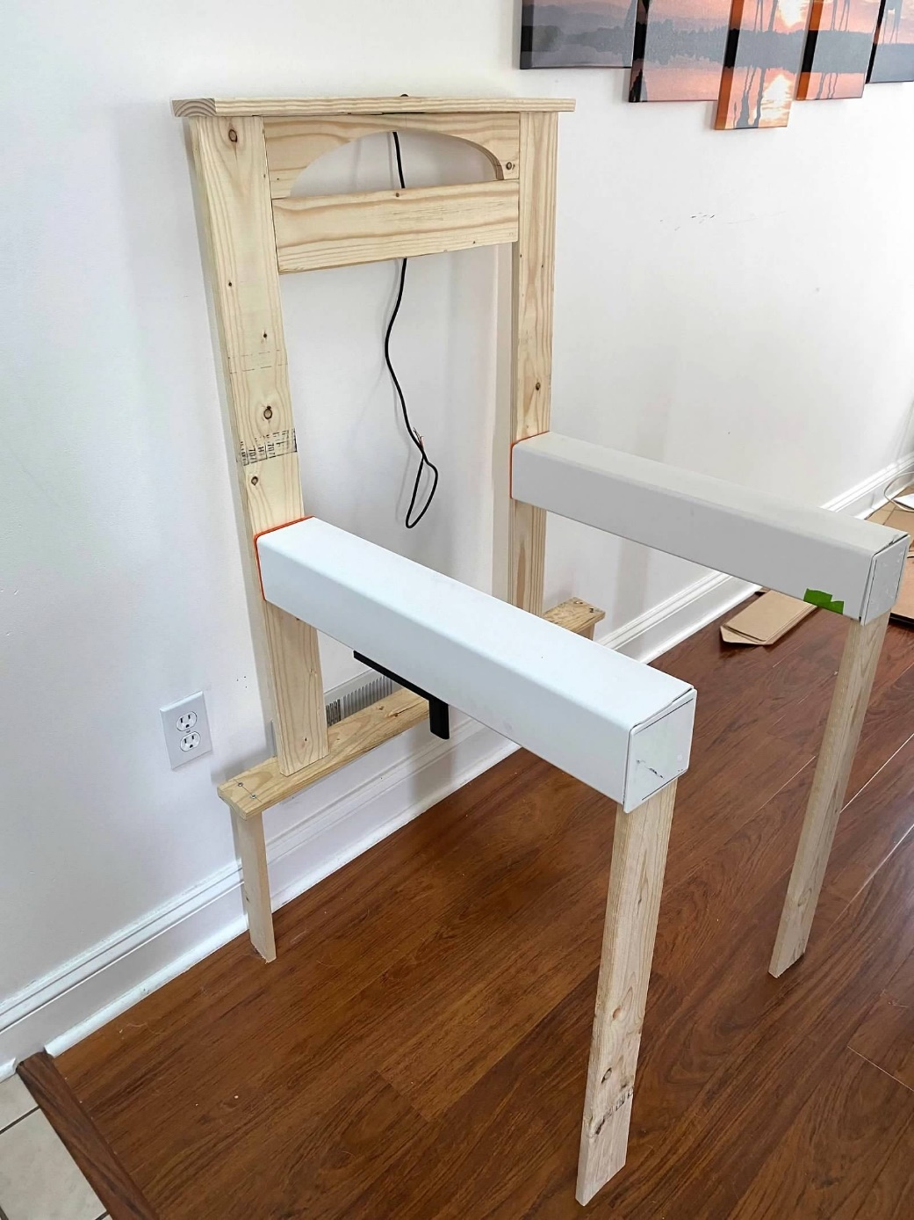
Back and legs were wood. The rear legs had to be cut so they did not hit the rear wheels of the chair.
Arms were 4x4 vinyl post cover. This was selected to make it more true to the actual chair, also selected for strength and weight
3DPrinted two plugs that fit into the vinyl post and screwed those into the back of the chair.

Slide 8
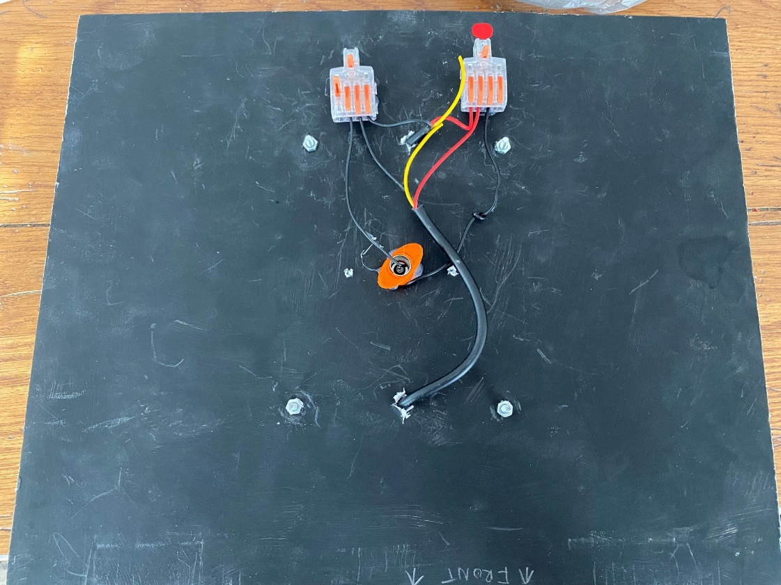
The wiring couldn’t be permanent since the bottom component had to be separated, so all of the connections were completed using quick connectors.

Slide 9
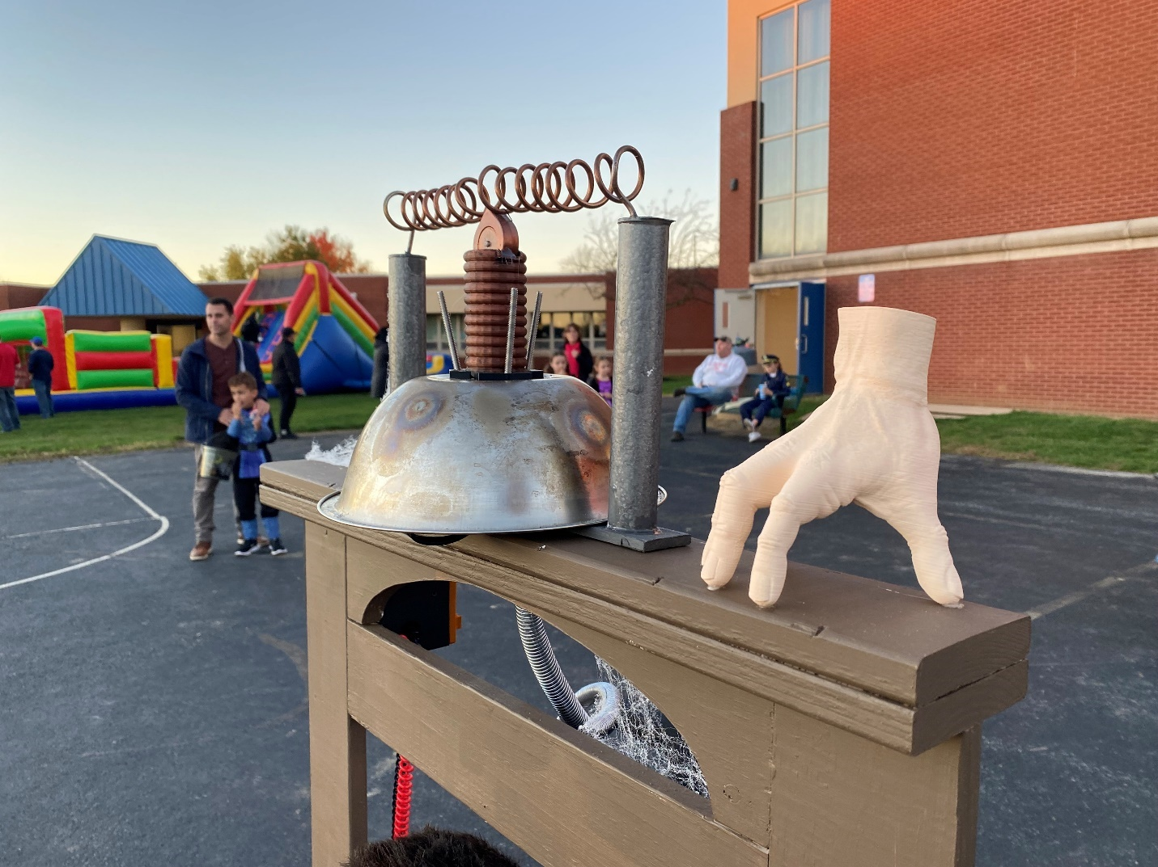
Thing was a model found on Printables, 3D printed in white and airbrushed
Top was made with a stainless steel bowl. Aged by scrubbing with steel wool, soaking with coffee after heating to 450 degrees, and then putting a butane torch to it.
Coil was a 3D print designed in tinkercad
Copper Wire wound around a ½ PVC
Terminal poles are 1/2 inch PVC
3DPrinted plugs at 100% to fit into the PVC, then heated the end of the copper with a butane torch and then inserted it into the PLA plug. Once cool, the wire was cemented in place.

Slide 10
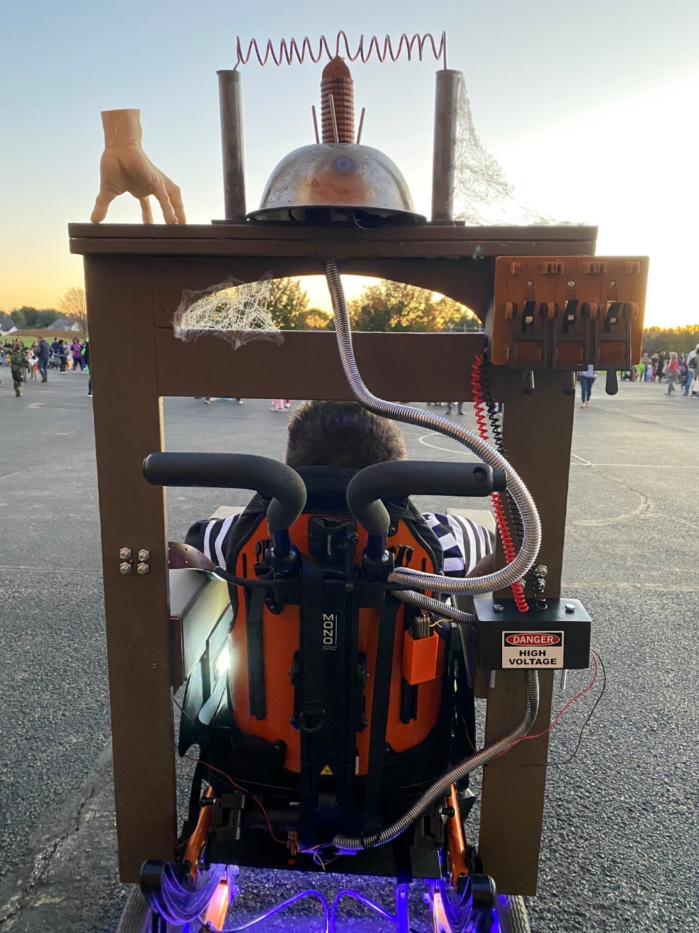
“Conduit” going from the top of the chair to the circuit box was some plastic wire cover from Harbor Freight tools spray painted silver. Purposefully didn’t get 100% coverage to give it an aged look.
Red and Black coiled wires were A/V .
High Voltage box was 3Dprinted and contained the battery and all the connections.
For the switches, I found a 3D model of mad scientist style paddles. Mounted them upside down, so when Wednesday pulled the paddles down she was actually switching the switches to ON.

Slide 11
3D Models:
Thing: https://www.printables.com/model/7804-addams-family-thing
Switchplate: https://www.printables.com/model/132335-frankenstein-light-switch-plate
Circuit Box: https://www.tinkercad.com/things/8lKgfbHrgrM
Pvc Plug: https://www.tinkercad.com/things/erAcKM3jeFV
Coil: https://www.tinkercad.com/things/ipjvP2ZEt3S
Vinyl Post Cap Covers: https://www.tinkercad.com/things/2o5lAG9CqhJ
Switchplate: https://www.tinkercad.com/things/4plEjOgXdPd
Components List:
https://www.amazon.com/hz/wishlist/ls/3S3E2HD3KSDKI?ref_=wl_share

